Slide 1
SFP Demo Configuration Handbook WxCC 2.0
CCBU Solution Assurance
Document version 1.0
30-10-2020

Slide 2
What is this about ?
What is this Not about ?
Anyone with a WxCC 2.0 tenant access should be able to configure it to demonstrate the capabilities of this platform in their own demo/Gold tenants.
This handbook will be shared internally first (TME, TSA, Sales, Mktg) and eventually to partners in EFT
This is a ‘living document’, more capabilities will be added as they become available
This helps provide a consistent demo experience
Training/Deep dive session
Step by Step demo guide/story with speaker notes (Will be a separate effort)

Slide 3
Overall Pre-Requisites / Assumptions
1 | Steps in this guide are based on and for configuring a tenant in production environment
2 | Users of this guide already have administrator access to a production tenant
3 | Voice connectivity is available on the production tenant
4 | DN to EP mapping is done with a working DN
5 | Users of this guide already have Email ID for email contact routing
6 | Users of this guide already have a SMS Number procured from MessageBird, that can be integrated with the tenant.
7 | Users of this guide already have a Facebook page which can be integrated with the tenant
8 | Users of this guide already have a Google CCAI account that can be configured in the tenant
9 | Tenant has Feature Flags enabled for desktop layout, Chat/Email, Virtual Assistant, Social, FlowControl
10 | All config entities are created with prefix MediAssist For example: Site: MediAssist_Site, Team: MediAssist_Team, EP: MediAssist_Voice_EP

Slide 4
Config Handbook - Who & Where ?
Module-1 | User Onboarding | Ankit
Module-2 | Chat | Abhishek
Module-3 | Email | Naveen
Module-4 | Social | Chandra
Module-5 | Voice | Avinash
Module-6 | WxM Post Call Survey | Raghu
Module-7 | External DB Dips | Chandramouli
Module-8 | Agent Desktop(KAD) | Sameer
 | Support/Facilitator | Gagarin
 | Reviewers/Mentors | Karthik/Mudit
Environment | ProdUS1 (WxCC US DC)
Org | Webex CC Demo 101
Org ID | 12700722-cd25-46b9-971e-ed0ce9f140c6
Access | <cec>@email.carehybrid.com
Control Hub | https://admin.webex.com
Portal | https://portal.wxcc-us1.cisco.com/portal/home.html
Agent Desktop | https://desktop.wxcc-us1.cisco.com
Main IVR | 516-517-9009
Sample API for Ext. DB Dip | https://5f9a64f59d94640016f709bf.mockapi.io/api/customers/account

Slide 5
Objective: This lab is designed to ensure we onboard various user personas in to WxCC.
As part of this guide, we will cover following steps:
Important: Let's use a naming convention in order to help us maintain this tenant. Please use the format from below. Most important, always lead with you username.
Voice Configuration:
Create EP = <username>_voice_EP ie: (ntheolog_voice_entrypoint)
Map DiD to your EntryPoint.
Create your Team = <username>_team
Create Q = <username>_voice_Q
Create EP Routing Strategies = <username>_RS_voice_EP
Create Q Routing Strategies = <username>_RS_voice_Q
Associate Teams to respective Q

Slide 6
Module 6
External Database Dips

Slide 7
Objective: You will be able to demonstrate the capability to perform an external database dip using HTTP connector and fetch a variable form External Data using API and play the same using Google TTS
Pre-Requisites/Assumptions
Outcome
New user (Agent) is already created
Agent is able to login to agent desktop
Agent has the capability to accept voice contact
Google TTS is configured and working refer (https://sharevideo.cisco.com/#/videos/0200e011-d681-4c47-b409-1a7a61e6bee9 https://cisco.sharepoint.com/:p:/s/CCBUEMEAR/EVOb3PzmaeZDmRmDwDhh88MBOYSl3_g_ZIJ7sgebkHF4-g)
Complete configuration of Custom connector integration with WxCC (Control Hub)
Utilize the custom connector within the flow utilize retrieved info to make routing decision
Utilize retrieved info in conjunction with TTS/variables to playback a custom message to caller

Slide 8
Objective: Utilize the HTTP Request activity within Flow to perform an external Database dip and utilize the retrieved information for various use cases.
Accomplishing above Objective is threefold process
1) Create your Own API Endpoint, or follow the Step given here for POC
2) Control Hub Onboarding
Create Google TTS Connector(Refer the document shared in previous slide, Prerequisite)
Create Custom API connector
3) Portal Configuration
Create Entry Point
Create Flow Control
Create Routing Strategy
Tie Entry point, routing Strategy and Flow Control with Dial number
Make a Test call

Slide 9
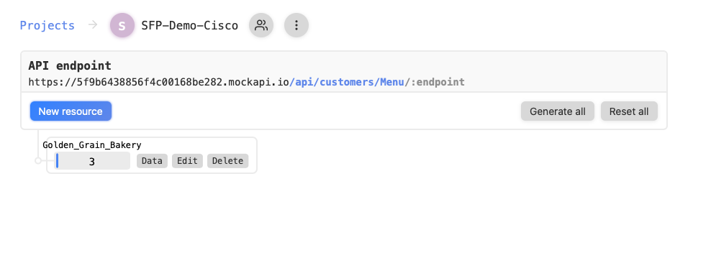
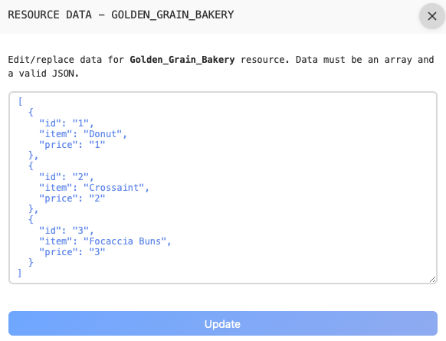
Step1: Create API Connector
Sign in to https://mockapi.io
Create Project
Add API Endpoint
Update the JSON Document
Cisco does not approve this website ; this is free API website available online.

Slide 10
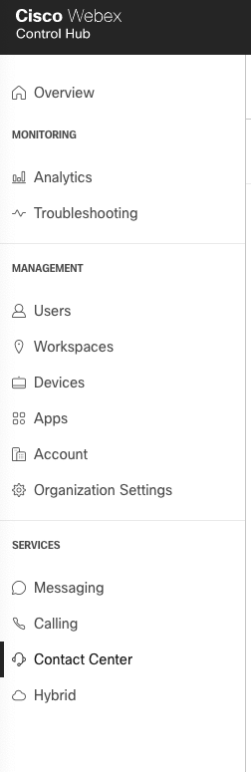
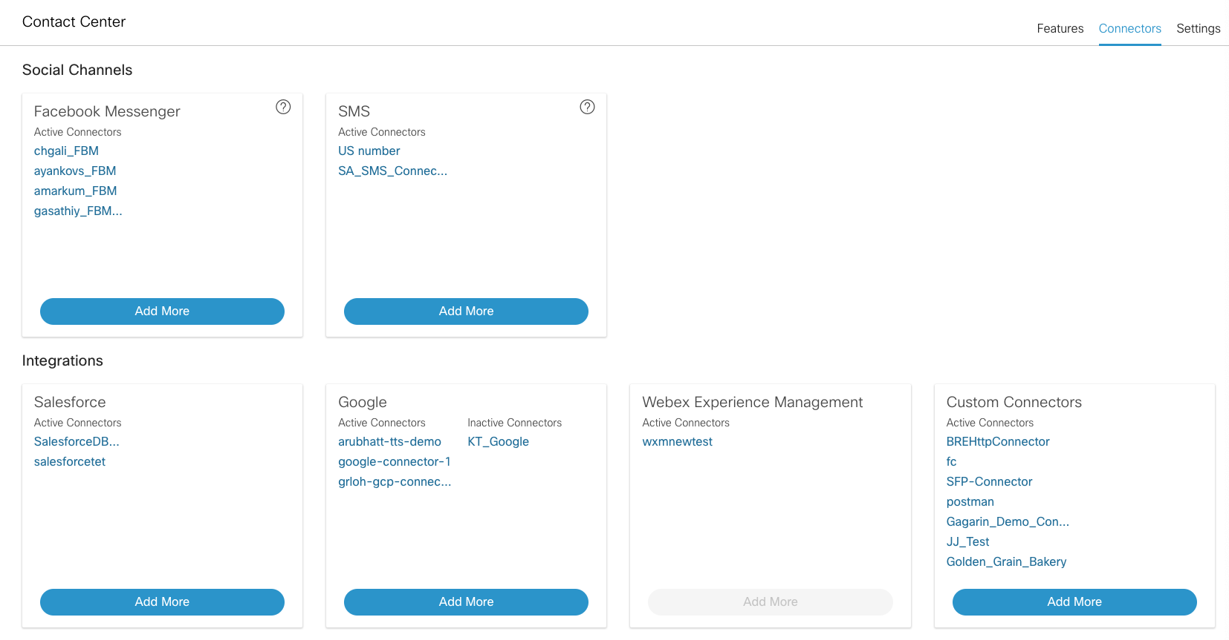
Step2: Login to Control Hub →Contact Center →Connectors

Slide 11
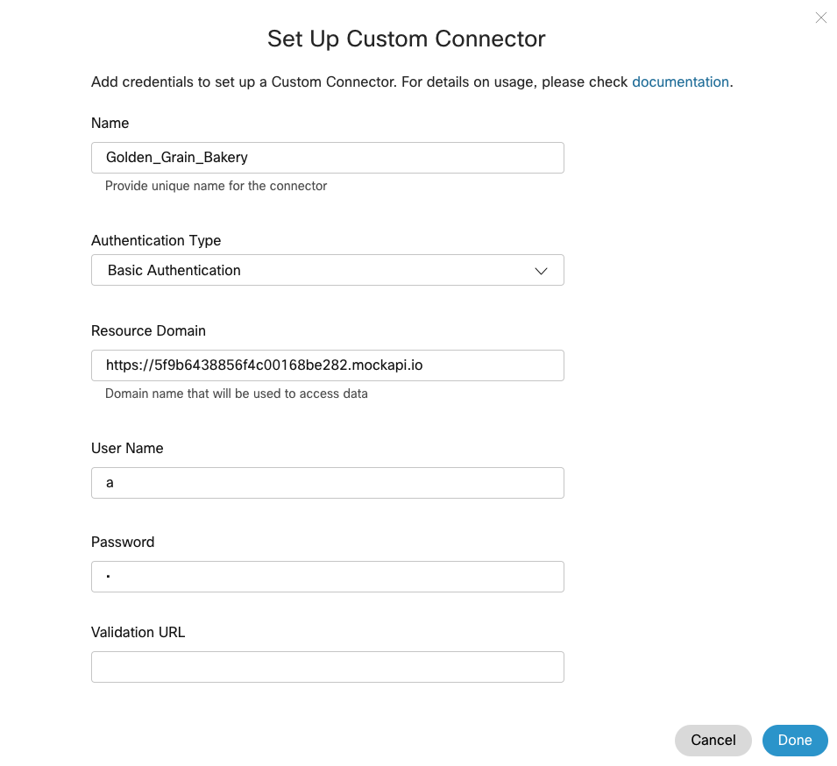
Informational: Since this MockAPI website has no Authentication we don't need to create a connector. You can just use a HTTPRequest Block and add the website URL there... (slide 17)
Step3: Click on Add More
Name : Name of your connector
Authentication: Basic or OAuth2.0
Resource Domain : Enter the domain URL (only "https://" prefix is allowed).
Username :
Password :
SAMPLE
SAMPLE

Slide 12
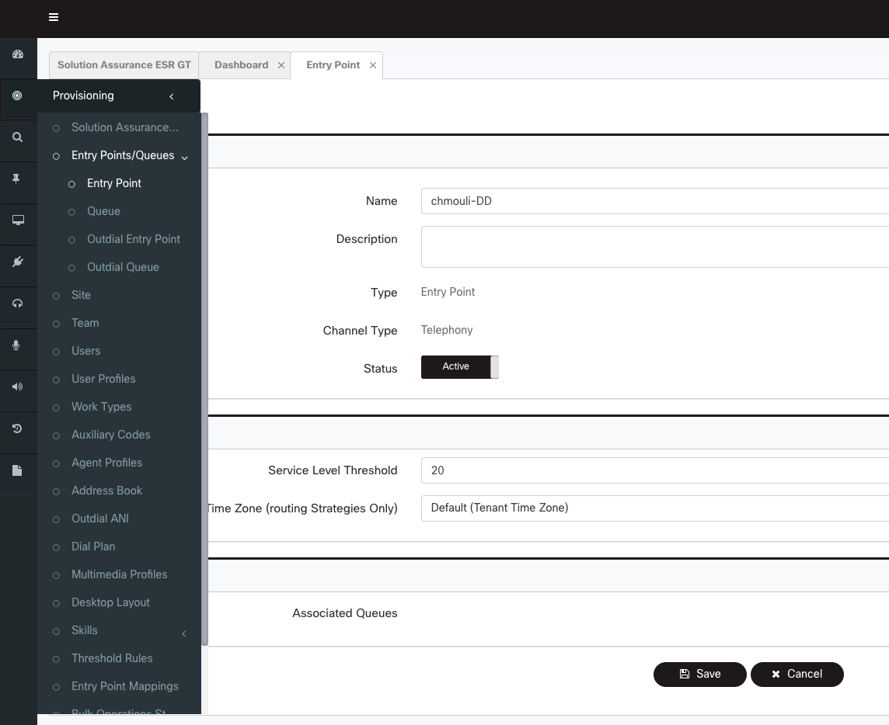
Step4: Login to https://Portal.cjp.cisco.com →Provision →Entry Point/queue
Name : Any name of your choice
Type :Entry Point
Channel Type : Telephony
Service Level : Any Value >0

Slide 13
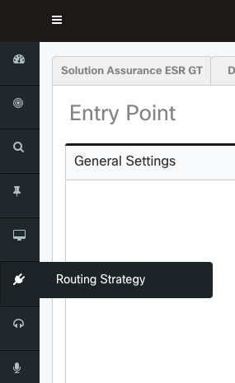
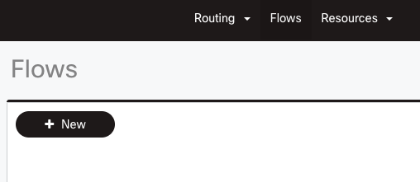
Step5: Create Flow Control Script
Portal →routing Strategy
Flow →Press New

Slide 14
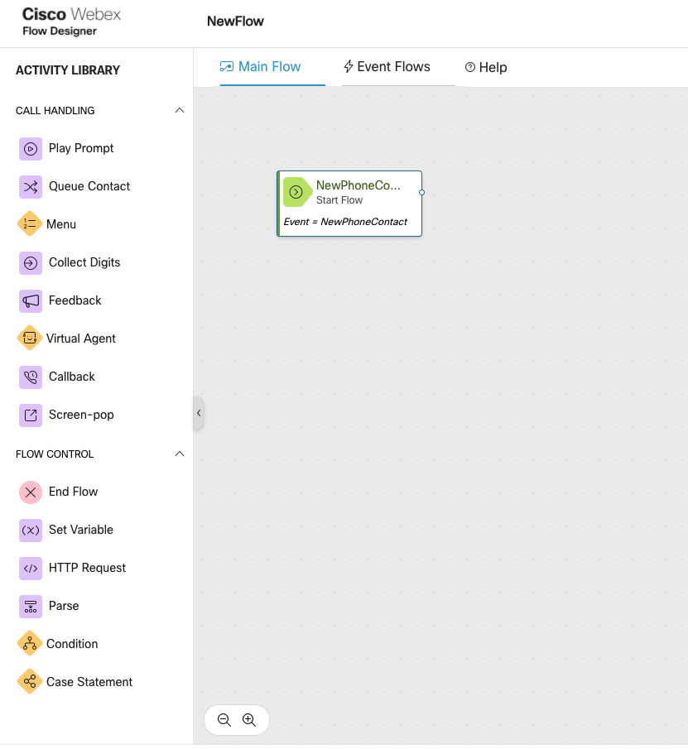
Step6: Create Flow Control Script
Upon Clicking new→ new window will pop open with Flow canvas

Slide 15
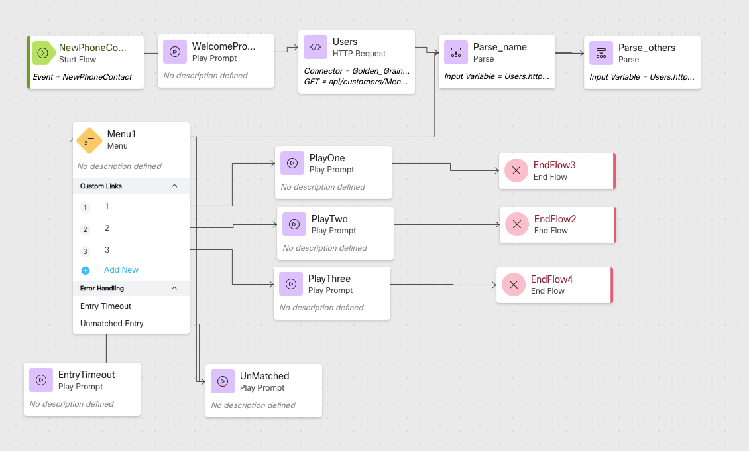
Step7: Create Flow Control Script
Overall idea is to:
Greet the customer
Fetch {Bakery menu, catalog id, price } from API using HTTP Node
Parse the variable and store in local custom variable
Offer Bakery menu for customer to choose
Play out catalog id, price and open hours
End the flow

Slide 16
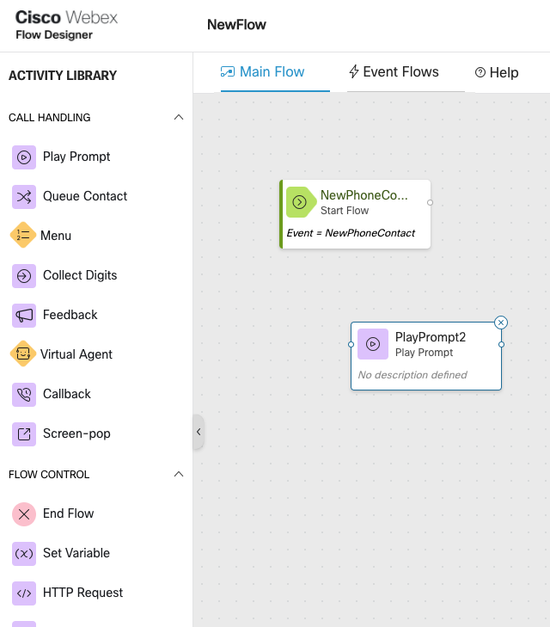
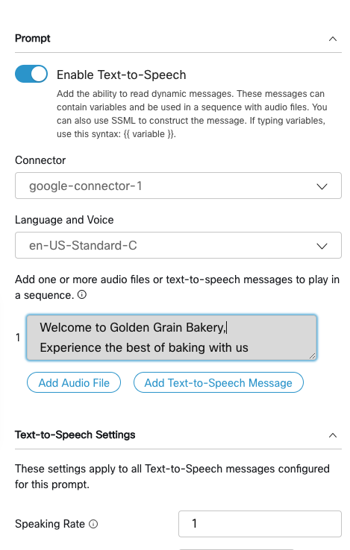
Step8: Create Flow Control Script – Play prompt Node
Drag Play message node to canvas
Enable Text-to-Speech
Select the google connector configured in Control Hub
Add Text-To-Speech-message

Slide 17
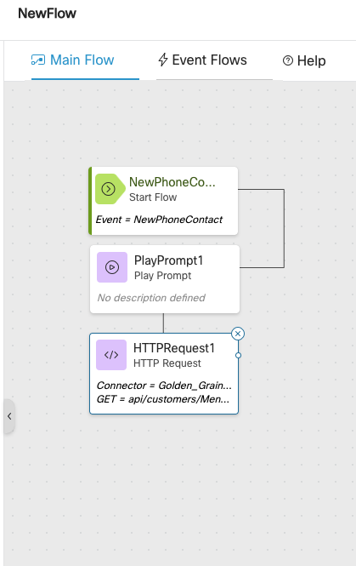
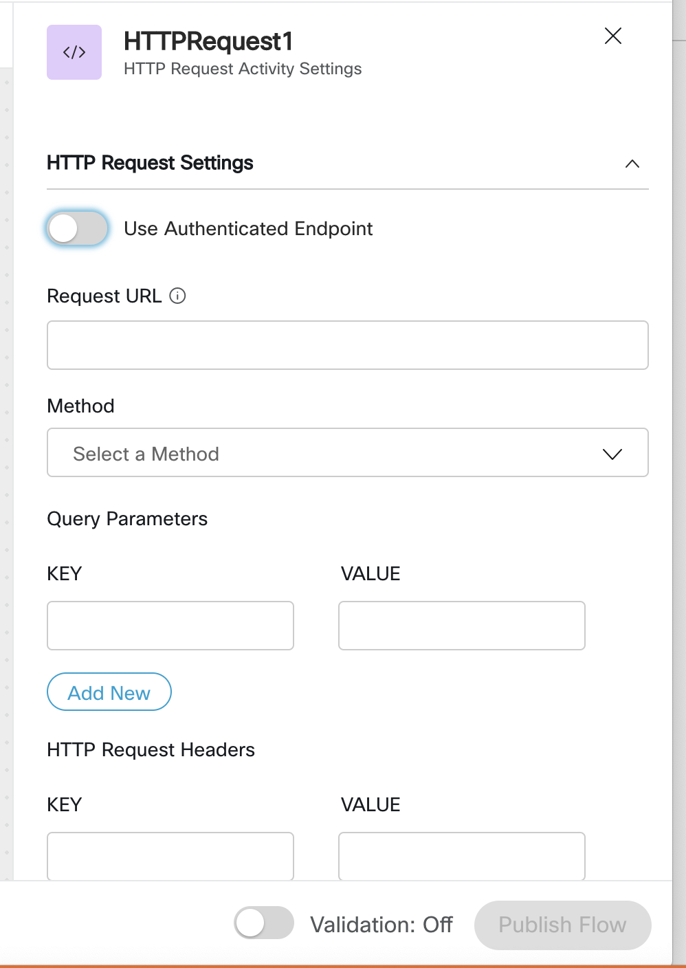
Step9: Create Flow Control Script – HTTP Request node
Drag HTTP Request node to canvas
2) Use Authentication should be off (don’t need a connector as mentioned in slide 11)
3) Request URL is to form complete API request “api/customers/Menu/Golden_Grain_Bakery”
4) Method : GET
5) HTTP Header
Content-Type : Application/Json

Slide 18
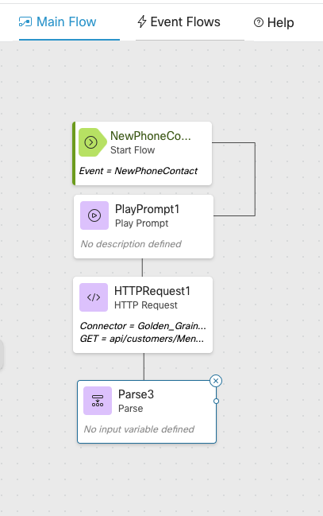
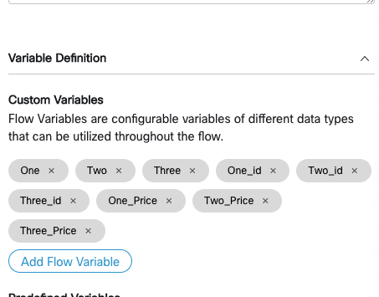

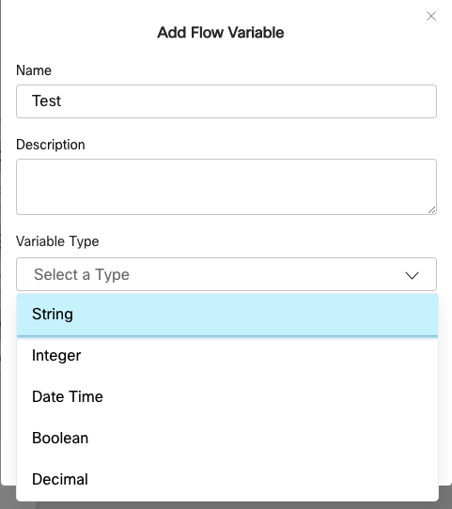
Step10: Create Flow Control Script – Create Custom Variable
Click anywhere in the canvas
2) Click on from the top right corner of the canvas
3) General Setting form will pop open, press ‘Add flow variable ’
4) Create flow variable with correct variable type
Note: To send it to Google TTS, String is preferred

Slide 19
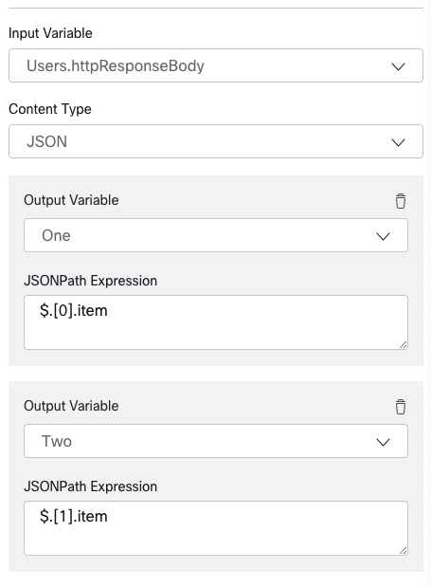
Step11: Create Flow Control Script – Parse Node
Drag Parse node to canvas
(note: parsing can also be done in the HTTPRequest Block) new feature since this was written
2) Input Variable is
<nodname>.httpResponseBody
3) Output variable – Any Custom variable created
4) JSONPATH : is to parse exact variable from the API request
Use below link to parse Json: https://jsonpath.com

Slide 20
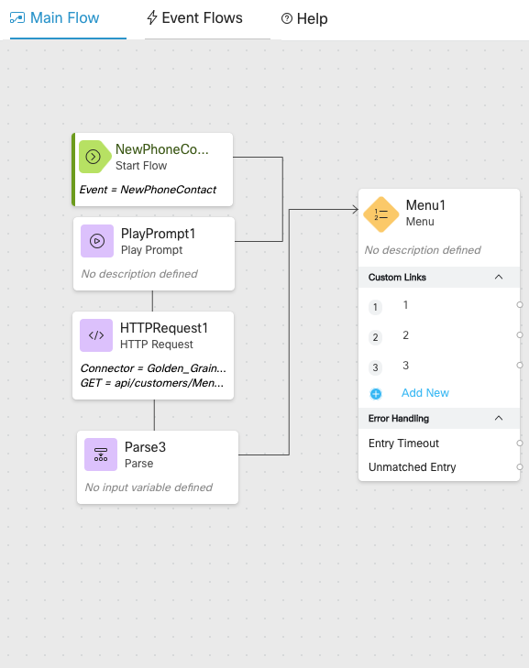
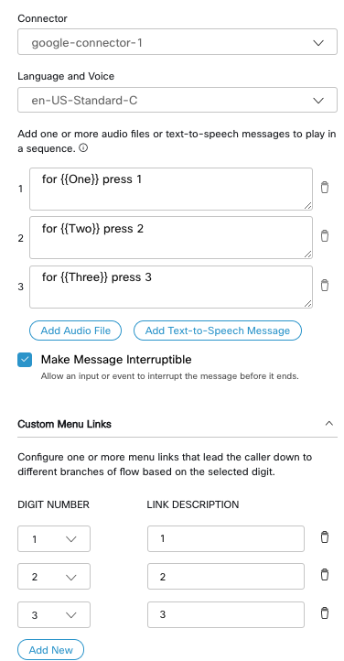
Step12: Create Flow Control Script – Menu Node
Drag Menu to canvas
2) Select Google Connector for TTS
3) To play custom variable, add the custom variable between 2 curly braces, ex:{{<custom variable>}}
4) Create Menu link and connect to corresponding Play Node

Slide 21
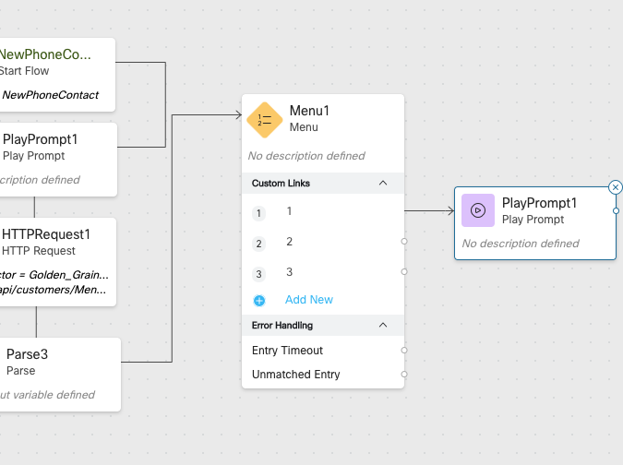
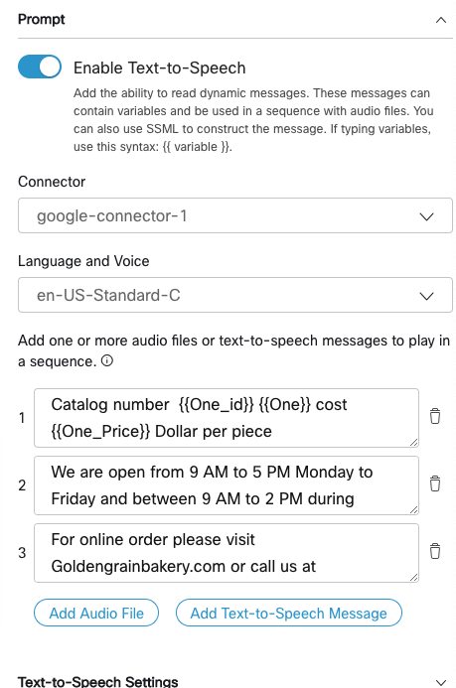
Step13: Create Flow Control Script – Play fetched variable
Drag Play prompt to canvas and connect to corresponding Menu link
2) Select Google Connector for TTS
3) To play custom variable, add the custom variable between 2 curly braces, ex:{{<custom variable>}}

Slide 22
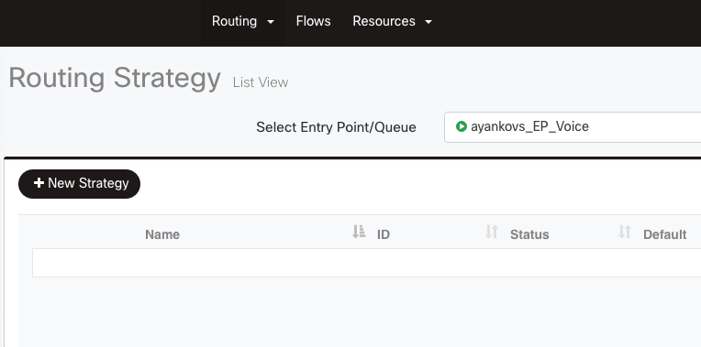
Step14: Create Routing Strategy
Portal →routing Strategy
Routing Strategy →New Strategy

Slide 23
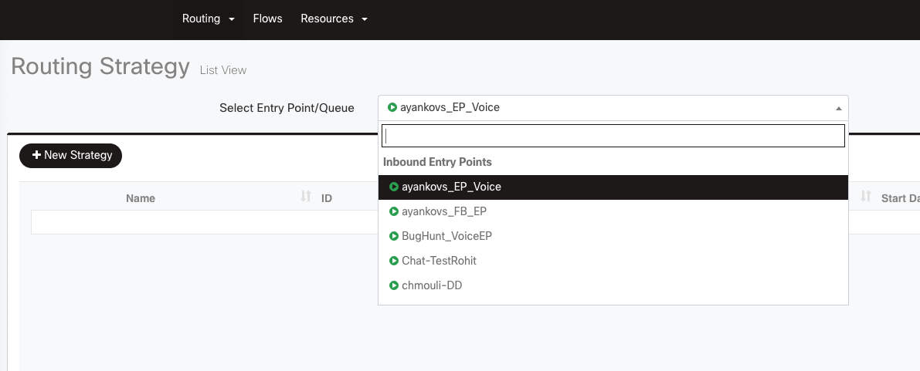
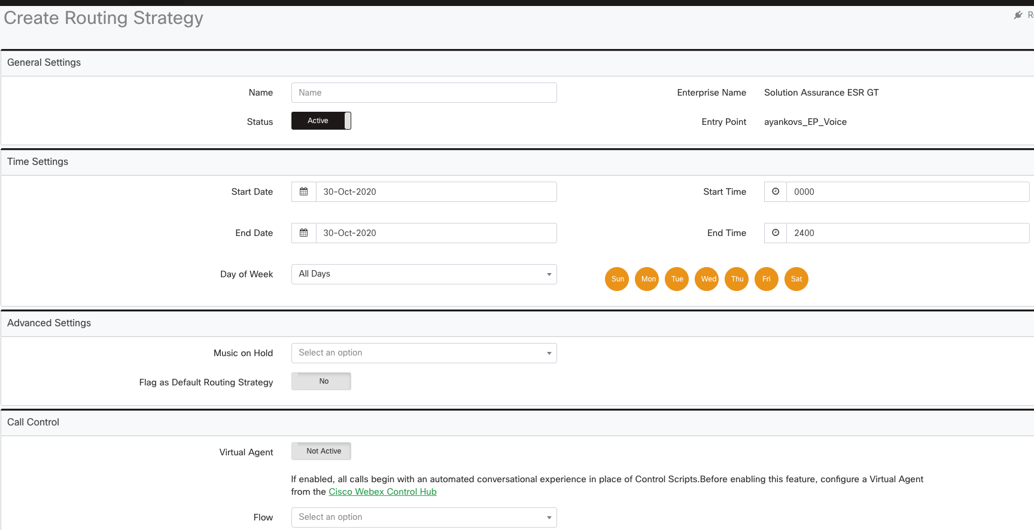
Step15: Create Routing Strategy
Select Entry point for which the Routing strategy needs to be created
Routing Strategy
Name → Name of your Bridge
Start Date
End Date
Day of week
MOH →Select .wav file
Flow →Associate the Flow created before

Slide 24
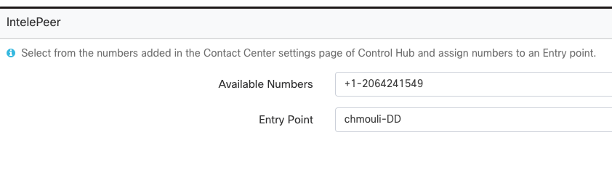
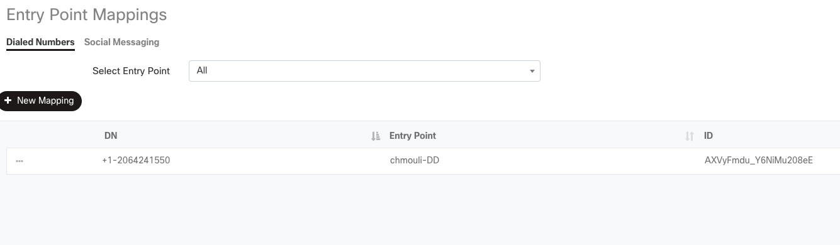
Step16: Associate Dial number to Entry Point
Associate Available number with Entry Point
Call the number

Slide 25
Summary:
You will be able to demonstrate the capability to perform an external database dip using HTTP connector and fetch a variable form External Data using API and play the same using Google TTS
Verify Below points:
Call the configured number and make sure data is fetched properly
Please proceed to Module-8 to continue the configuration

